Slide 1
Vulcan Defect Status
April. 25, 2016
Tao Wu, Wen Yi Gao

Slide 2
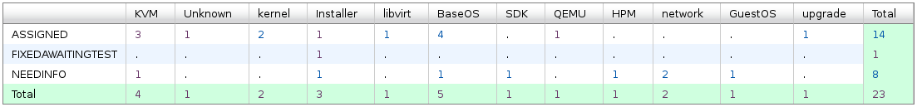
Vulcan - Open Defects
23 open defects excluding 12 HVM bugs.
7 defects new opened in the last two weeks. We solved 18 defects in the past two weeks.
Defect statistics:

Slide 3
Vulcan – High Priority Defects
No |  |  |  | Comp | Summary | Status | Comment
1 | 139984 | P1 | High | KVM | Guests hang when attempting to reboot on Vulcan FP1 | ASSIGNED | - Patch is being tested by the developer.
2 | 138613 | P1 | High | SDK | Customer is not able to install a Fixpack on a system with SDK installed | ASSIGNED | - Solutions are being discussed.
3 | 139772 | P1 | High | BaseOS | chmem -d crashes a Vulcan FP1 system running in a DPM LPAR | ASSIGNED | - A test rpm including the patch has been created. - Waiting for the reporter to verify.

Slide 4
Vulcan – All Defects
439 defects excluding 117 HVM defects opened in the Vulcan Bugzilla until now.

